Slide 1


St. James’s Episcopal Church
Congregational Presentation
Presented by: Elizabeth Hamilton, MSW, LSW

Slide 2
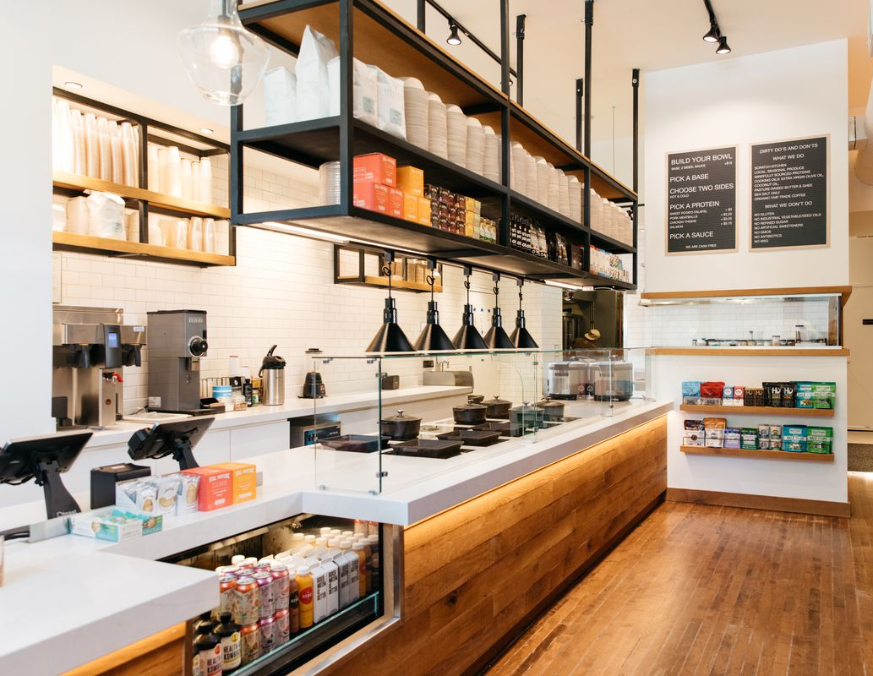

Why we do what we do the way we do it.
We all go through the report together at one time.
We benchmark.
We listen empathetically.

Slide 3

The Data is the beginning of the journey
326 Responses
103% of average worship attendance

Slide 4


Slide 5
Satisfaction
Peace
Fulfillment
Wholeness
Belonging
Meaningful relationships
Absence of discord
Energy
Compelling Sense of Purpose
Capacity for Action
Passion with Intention

Slide 6
High Energy
High Energy
Low Satisfaction
Chaos
Transformational
2017
Low Satisfaction
High Satisfaction
2024
Low Energy
Low Satisfaction
Low Energy
High Satisfaction
Low Energy

Slide 7

Drivers
More Energy or Satisfaction
When things done well
Less Energy or Satisfaction
When things are not done well
What MOOOOves you

Slide 8

Drivers based on age
Bridges of Understanding

Slide 9
The Clergy focused Congregation
Satisfaction
And Energy
Do I like the Rector?
Do I like what the Rector is doing?
How is my relationship with the Rector?
Excellent Worship

Slide 10

Realistic Expectations

Slide 11
A Healthy Clergy-focused System
The “musts”:
Accountability, Agency and Leadership skills
Built in consistent support for clergy
High level conflict management skills
Anxiety that is managed well about clergy changes (adaptive change)

Slide 12
Three priorities for your congregation
Growth: Comprehensive strategy to reach new people and incorporate them into the life of the church
Pastoral Care: Strengthen the pastoral response of the church in serving people in times of need.
Stewardship: Develop the spiritual generosity of the people to financially support the ministry of the church.
Over the 90% percentile in the benchmarking

Slide 13

Your Congregational Culture

Slide 14


Descriptive Map
Adaptable
MAGI
PERFORMANCE
MAGI
PERFORMANCE
Progressive
Conservative
PARACLETE
HEARTH
AND HOME
HEARTH & HOME
PARACLETE
Settled
113

Slide 15
Paraclete Culture at Its Best
Develop communities that are intellectually open and reflective but that pays attention to structure and ritual.
Common to hear conversation about hospitality, inclusiveness, and spiritual practice.
Comfortable with the unique spiritual path each individual must follow but believe that there are important patterns to spiritual practice.
Uniquely equipped to focus on ministries of healing-often engaged in front line work-when the community is warm and hospitable, it can be a haven for those in need of healing or recovery.

Slide 16
Paraclete Shadow Side:
If missional focus is lost may find themselves going through the motions of set routines, rather than finding the deeper meaning.
Watch the temptation to overcommit to meeting the needs of others to the extent that there is burnout.
May get trapped in the acceptance of where people are without adequate levels of accountability that can help make people whole.
The power of the gospel to transform must remain a focus, not just its power to comfort.

Slide 17
Performance Indices
So how are we doing?

Slide 18
Let’s talk Benchmarking
Very Low
0-10
Low 10-30
Average
30-70
High 70-90
Very High
90-100

Slide 19
Conflict Management and gOVERNANCE Index
Is there a disturbing amount of conflict in our congregation?
Do we resolve our problems through mutual effort?
Among most of our members is there a healthy tolerance of differing opinions and beliefs?
Is there frequently a small group that opposing what the majority wants to do?
Do leaders show genuine concern for what people are thinking when making decisions?
Do the SAME small group of people make most of the decisions?
In important decisions is there consideration of different approaches to that decision?
Is the leadership representative of the membership?

Slide 20
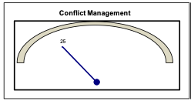
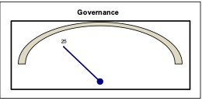
Conflict Management and gOVERNANCE Index

Slide 21
hOSPITALITY
Are we welcoming and enriched by people from many different walks of life?
Has being a part of the church community given new meaning to my life?
Do I sense a friendly atmosphere among the members of our church?
In times of personal need to a sense an atmosphere of genuine care and concern?
Have members been prepared to personally welcome guests in worship service?

Slide 22
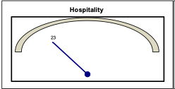
Hospitality Index
Very Low
0-10
Low 10-30
Average
30-70
High 70-90
Very High
90-100

Slide 23
Readiness for ministry and Educational engagement Index
Our church does a good job helping each member understand that he or she is called to ministry.
Do we do a good job helping members understand they are called to ministry?
Do we prepare our members for ministry by helping them discern gifts?
Do we provide opportunities for members to engage in active ministry within the church and world?
Do we do a good job supporting persons in ministry by reminding them they are making a difference?
Do our lay people work with the clergy in leading and planning worship?
Do our members understand that they have a spiritual responsibility for life-long learning and formation?
Do we provide opportunities for education and formation in a variety of ways so that individuals can find one that fits their complex life style?
Do we provide high quality education that is appropriate to every age and stage of life?

Slide 24
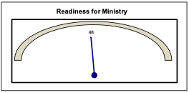
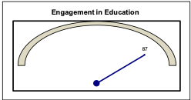
Readiness for ministry and Education engagement

Slide 25

Spiritual vitality
Do my spiritual experiences often impact the way I look at my life?
Is my spiritually the basis of my whole approach to life?
Do I experience the presence of God in my life?
Do I work to connect my faith to all other aspects of my life?
Although my faith is important to me, do I feel there are other things more pressing in my life right now?

Slide 26
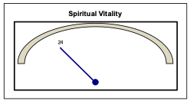
Spiritual Vitality
Index
Very Low
0-10
Low 10-30
Average
30-70
High 70-90
Very High
90-100

Slide 27
Worship and Music
Is the music at our church outstanding in quality and appropriate in style in our congregation?
Are the worship services at our church exceptional in both quality and spiritual content?

Slide 28
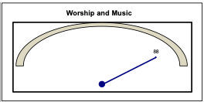
Worship and Music
Index
Very Low
0-10
Low 10-30
Average
30-70
High 70-90
Very High
90-100

Slide 29

Next steps
Listening Sessions Prep
Listening Sessions

Slide 30
What these do:
Build relationships
Help people feel listened to
Build understanding
Notes:
We keep generations mixed up and backgrounds so we are building relationships across the congregation

Slide 31
What they are not:
Airing of grievances
Feats of verbal strength
Listening to respond

Slide 32



Dreaming together of:
Preferred future
What it feels like
What it looks like
And how you can be a part of getting there

Slide 33
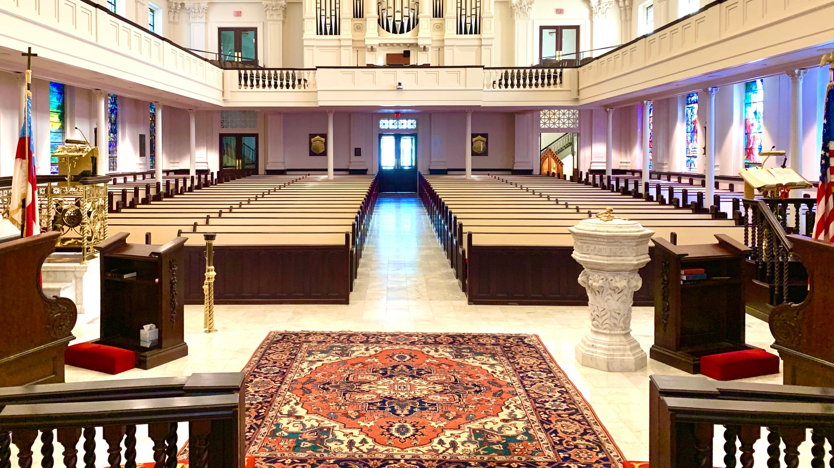
By wisdom a house is built, and through understanding it is established; through knowledge its rooms are filled with rare and beautiful treasures
Proverbs 24:3

